Slide 1
Student Management & Attendance System using Face Recognition
ADITYA PAUL
1MS21MC003

Slide 2
Problem Definition
The traditional student management and attendance taking process is time-consuming and prone to errors.
Manually taking attendance is a tedious task that requires significant time and effort, especially in large classes.
The manual process can result in inaccuracies in student records and attendance records, which can have negative consequences for both students and administrators.
The need for a more efficient and accurate system for attendance taking is crucial for the proper functioning of student management.
This project proposes a solution to these issues by incorporating face recognition technology into the student management system.

Slide 3
Objectives
The primary objective of the project is to develop a student management system that incorporates face recognition technology for attendance taking.
The system aims to improve the efficiency and accuracy of the attendance taking process compared to the traditional manual method.
The project also aims to provide a more convenient and user-friendly interface for teachers and administrators to manage students' information and attendance records.

Slide 4
Hardware Requirements
Camera : High resolution of camera atleast 720p
Processor : Atleast i3
Memory : Minimum of 8GB of RAM
Storage : Minimum of 256GB of HDD/SSD
Display : A monitor

Slide 5
Software Requirements
Operating System: Windows or Linux.
Face recognition Technology : OpenCV.
Database : MySQL or PostgreSQL
GUI: Tkinter.

Slide 6
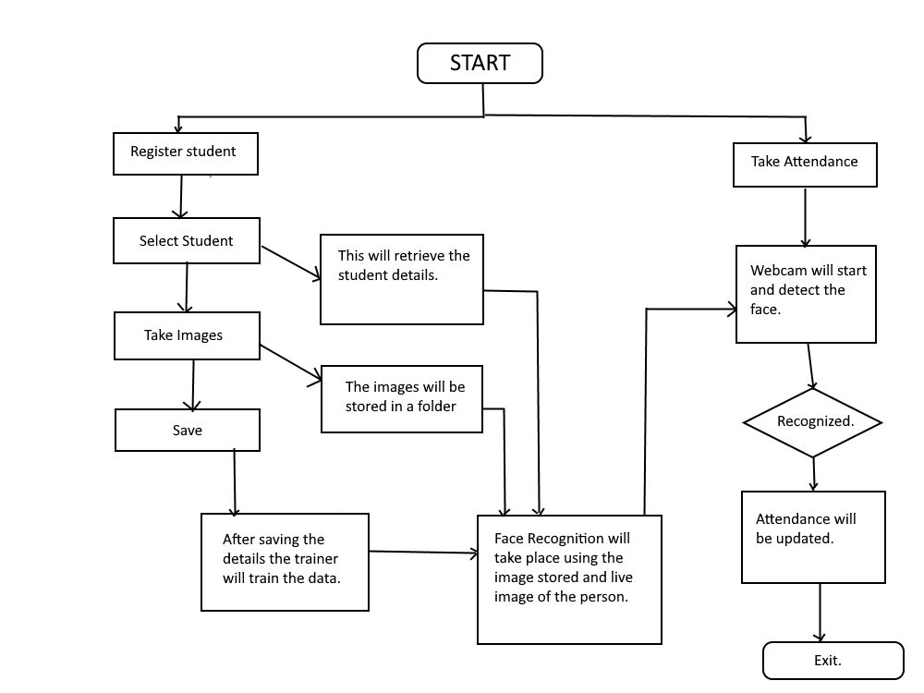
System Design
Architecture Diagram

Slide 7
System Design: Modules
Login Page: It allows users to type a user name and password to log in.
Sign Up Page: The signup page (also known as a registration page) enables users and independently register and gain access to your system.
Home Page: The home page consists of many options such as student details, face recognition, attendance, help, train data, photos, developer, exit.
Student Details: This allows the admin or the user to enter user details and save it to the database.
Train Data: The photo sample which is taken is trained using a classifier.
Face Recognition: This allows users to detect the face and it will show all the details of the student.
Attendance: It shows the attendance details (present or absent). It can be also exported to a .csv file.
Photos: It shows all the photo samples taken.
Developer: It shows the details of the developer.
Help: It shows the working documentation of the application.

Slide 8
Implementation
Define the system requirements: Clearly identify the features and functionalities that the student management and attendance system will need to have in order to meet the needs of the users.
Design the database: Create a database schema that will store student information, class schedules, and other relevant data.
Develop the user interface: Create a user-friendly interface that allows users to navigate the system easily.
Implement the core functionality: Write the code that implements the core functionalities of the system such as student registration, attendance marking, etc.
Collect dataset of student faces: This can be done by taking photos of students and storing them in a database.
Train a face recognition model: Use the collected dataset of student faces to train a face recognition model using machine learning techniques.

Slide 9
Implementation
Integrate the model into the system: Use the trained model to integrate face recognition functionality into the student management and attendance system.
Attendance Marking : Deploy the system in the classroom setting and use it to capture images of students as they enter the room. The system will then use the face recognition model to identify each student and mark their attendance accordingly.
Data management: The attendance data will be stored in a database for future reference and analysis.
Access Control: Use the trained model to restrict access to certain areas of the school or college based on student identity.
Reporting: Generate reports on attendance and class participation for teachers and administrators.
Security: Ensure that the system is secure and that student data is protected against unauthorized access.

Slide 10
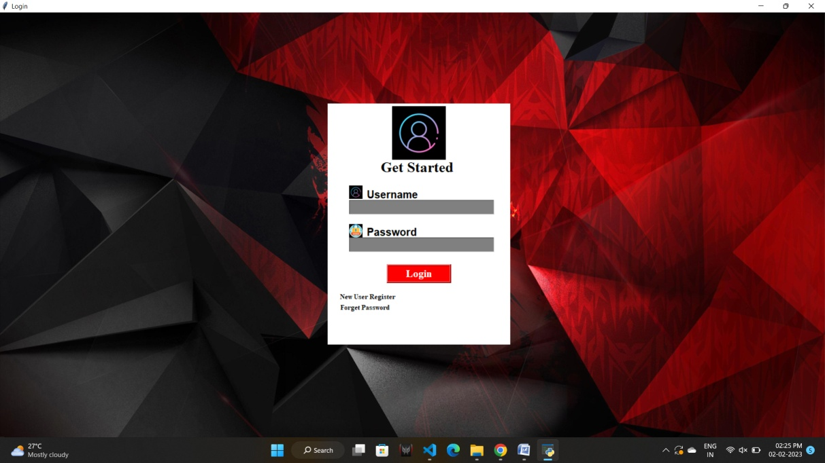
Result and Discussion
Login Page: This is the login page where users can enter their id and password to get access to the application. If users do not have their login credentials they can register as a new user. If users forgot their password then they can go to forgot password to reset their password.

Slide 11
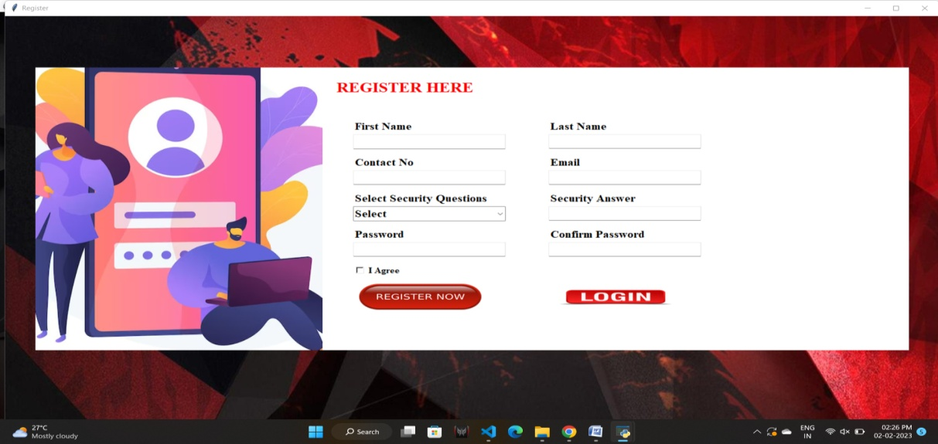
Result and Discussion
Registration Page: In this, the users can register to the application by providing the following details as shown in the figure, by registering they can have full access to the application.

Slide 12
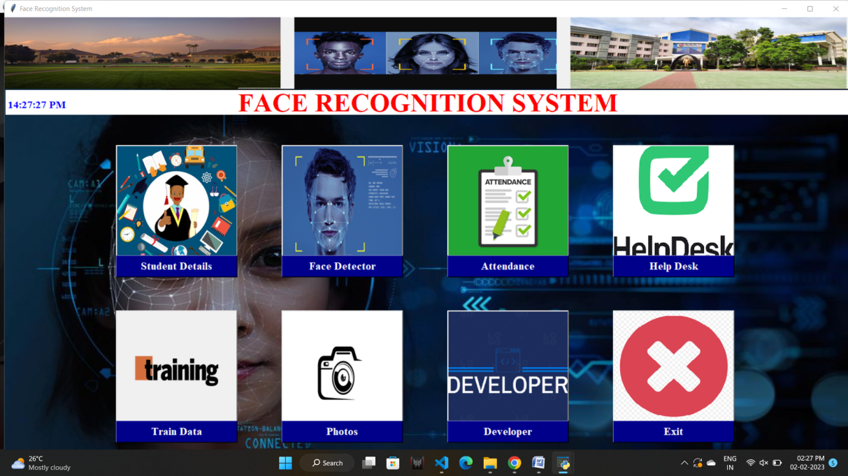
Result and Discussion
• Home Page: This is the home page and has various functions as such as student as shown in the figure.

Slide 13
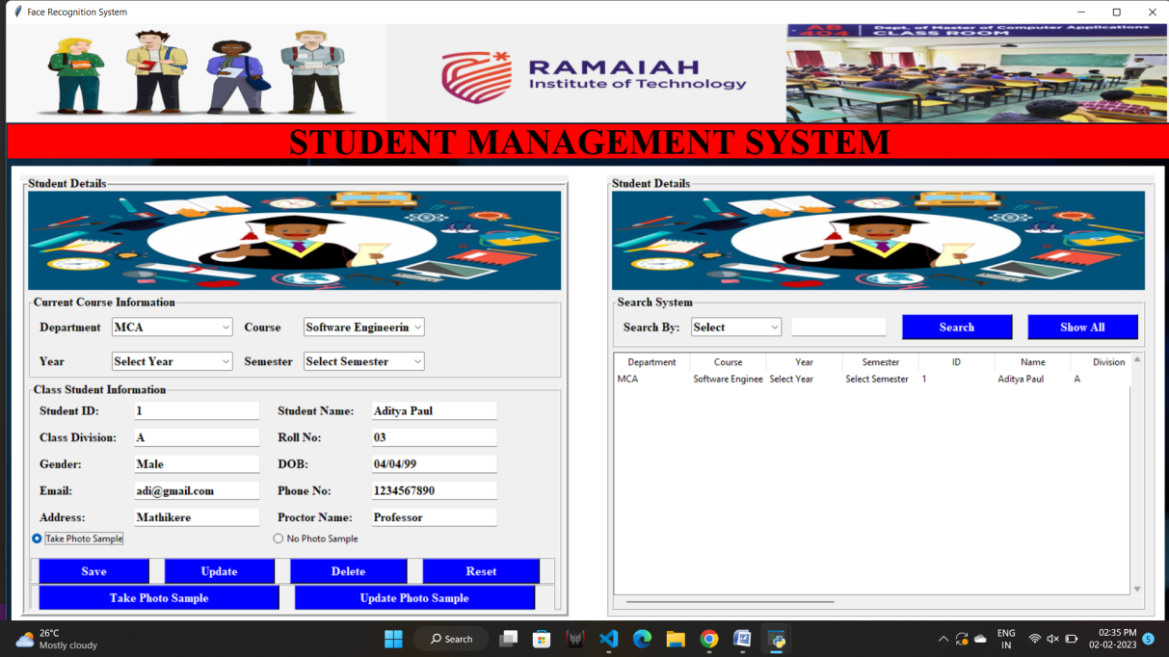
Result and Discussion
• Student Details: In this page the user can fill up the student details, update them, delete them and take the photo samples accordingly.

Slide 14
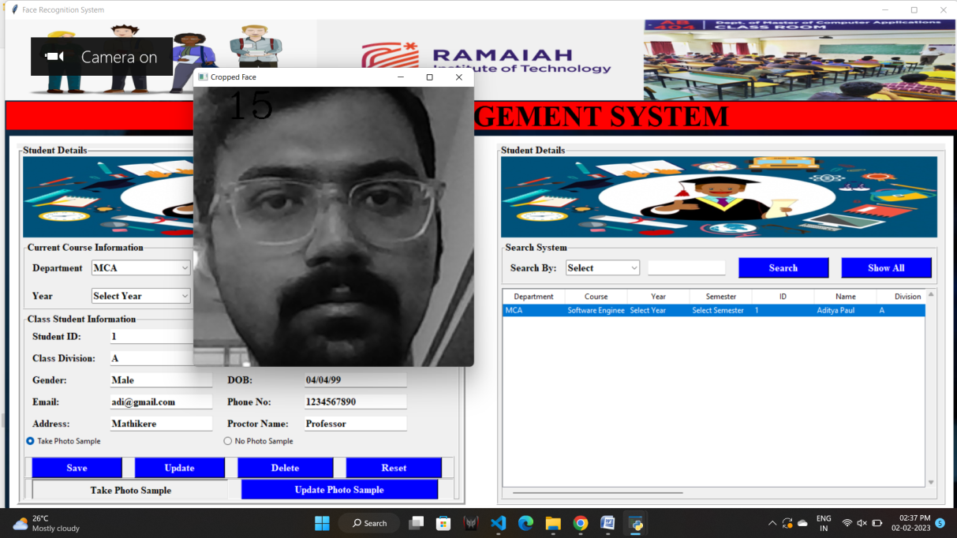
Result and Discussion
• This picture shows how the photo is captured of a student.

Slide 15
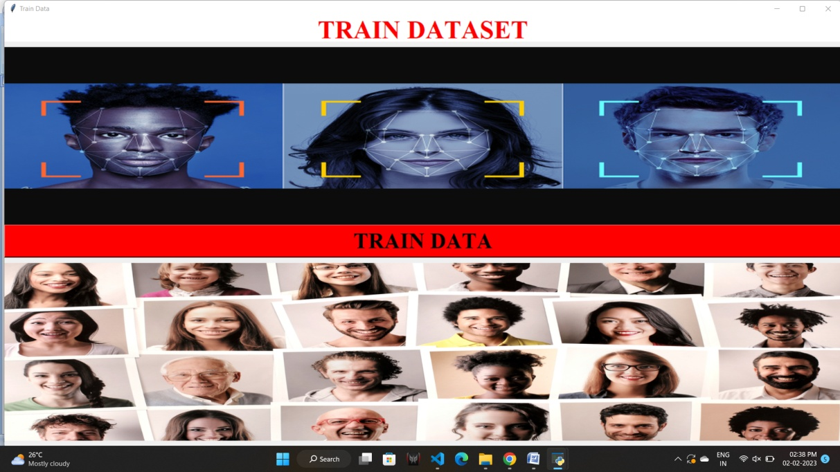
Result and Discussion
• Train Dataset: The below picture shows the training dataset window, in this the users can train their data generated, here the data is the human face and this is trained using LBHP algorithm.

Slide 16
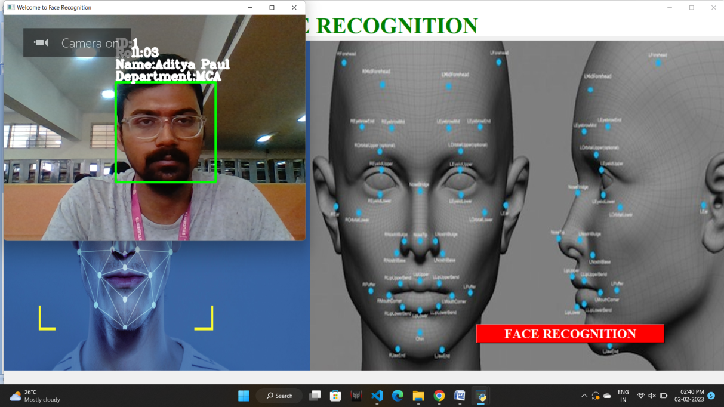
Result and Discussion
• Face Recognition: This window is used for face recognition, the user can click on the button to recognize the face of the student and then the data will be recorded in a .csv file.

Slide 17
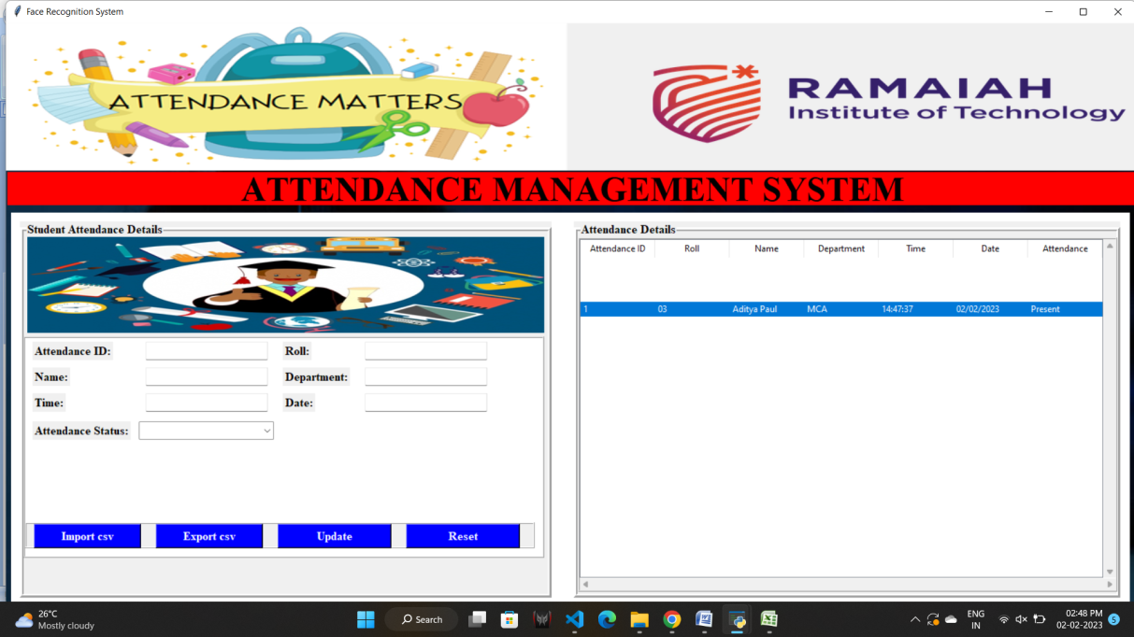
Result and Discussion
Attendance:This window displays the attendance in the application itself. The csv filecan be imported here and then updates can be done if needed. Then if any updates have been made the csv file can be exported as new csv to the system.

Slide 18

Result and Discussion
This is the .csv file where the attendance is being recorded as output.

Slide 19
Scope for Future Enhancement
The "Student management and attendance system using face recognition" project has great potential for further enhancement and growth. Some potential areas for expansion and improvement include:
Integration with other systems: Integrating the system with other software systems used by the educational institution, such as student information systems or learning management systems, can provide a more seamless and integrated experience for users.
Mobile application: Developing a mobile application that integrates with the system can provide students and teachers with real-time access to attendance information, even when they are not in the classroom.
Attendance tracking for remote learning: Adding support for remote learning, such as tracking attendance for online classes, can ensure that the system remains relevant and useful in today's changing educational landscape.
Improved accuracy and reliability: Improving the accuracy and reliability of the facial recognition technology can further enhance the efficiency and security of the system.
Customizable reports: Providing customizable reporting options for administrators can help them better understand and analyze student attendance data.
Advanced security features: Implementing additional security measures, such as multi-factor authentication, to ensure the privacy and protection of sensitive student data.

Slide 20
Conclusion
The "Student management and attendance system using face recognition" project aims to streamline the process of student attendance tracking and management. By utilizing facial recognition technology, the system eliminates the need for manual attendance marking and provides an efficient, accurate, and secure solution. The system's features, such as user management, student management, attendance management, report generation, and security, ensure that the system meets the needs of both teachers and administrators. The implementation of this system has the potential to greatly improve the efficiency and accuracy of student attendance tracking and management, making it a valuable solution for educational institutions. Overall, the "Student management and attendance system using face recognition" project offers a cutting-edge solution for a common problem faced by educational institutions and has the potential to improve the educational experience for both students and teachers.

